Slide 1
CSS Grid

Slide 2
Introduction
A grid can be defined with rows and columns. You can choose how to size these row and column tracks or they can react to the size of the content.
Direct children of the grid container will be automatically placed onto this grid.
Or, you can place the items in the precise location that you want.
Lines and areas on the grid can be named to make placement easier.
Spare space in the grid container can be distributed between the tracks.
Grid items can be aligned within their area.

Slide 3
Grid terminology

Slide 4
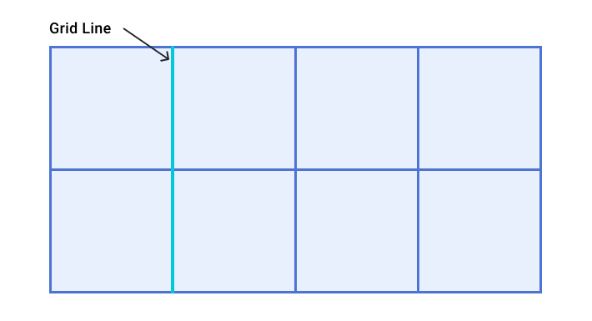
Grid Lines

Slide 5
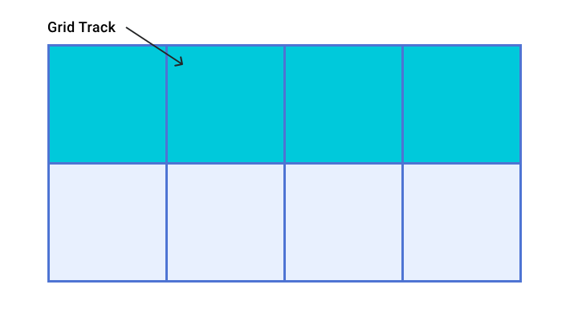
Grid Track

Slide 6
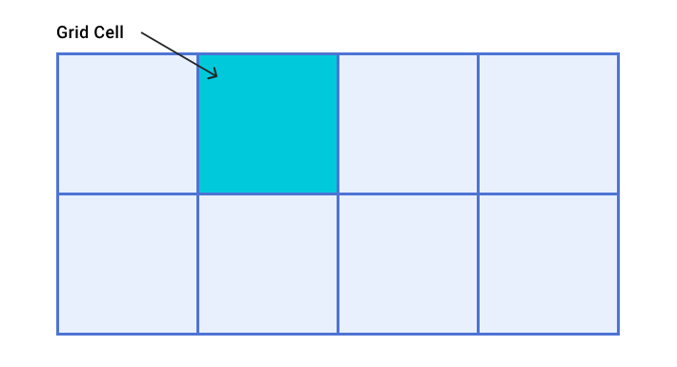
Grid Cell

Slide 7
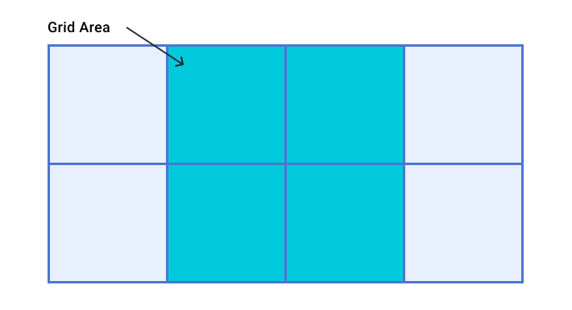
Grid Area

Slide 8
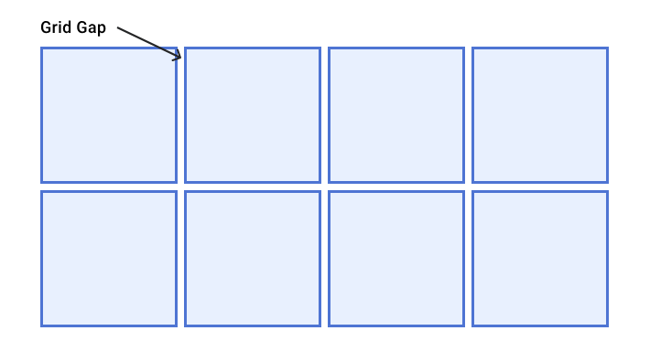
Grid Gap

Slide 9
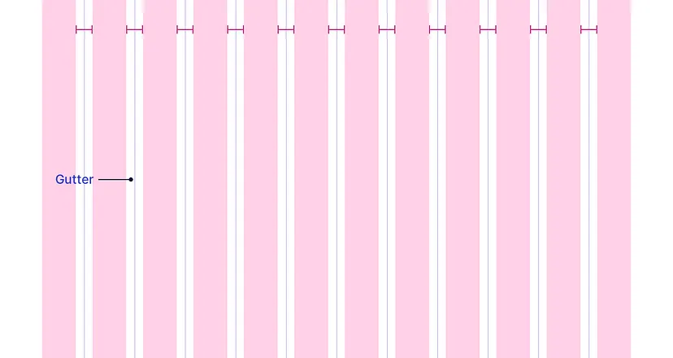
Gutters are the spaces between the columns. Gutters help to separate the content.

Slide 10
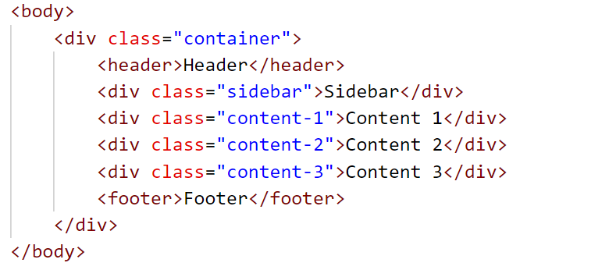
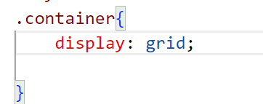
Grid Container
A grid container can be created by setting the display property with a value of grid or inline-grid. All direct children of grid containers become grid items.
A grid container's properties specify how browsers should layout items within the grid box model.

Slide 11
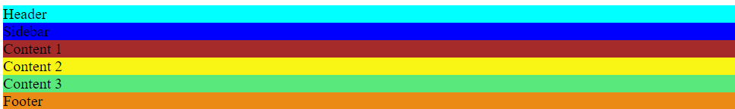

Slide 12
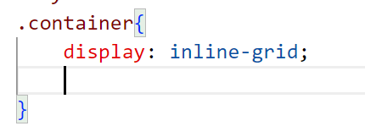
Inline Grid

Slide 13
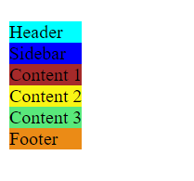

Slide 14
Explicit Grid
When we use grid-template-columns and grid-template-rows we create an Explicit Grid.
grid-template-columns specifies the number and widths of columns browsers should display in the selected grid container.
.container{
height: 50vh;
display: grid;
grid-template-columns: 15% 60% 25%;
}

Slide 15
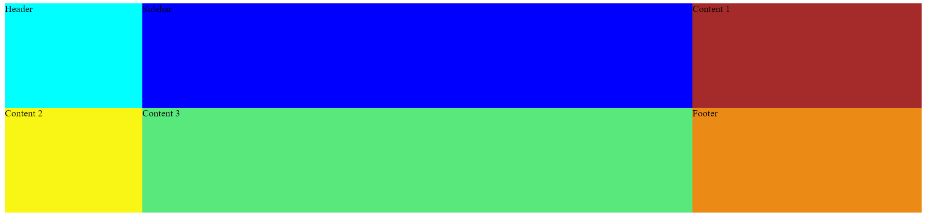

Slide 16
Grid-template-rows
.container{
height: 50vh;
display: grid;
grid-template-columns: 15% 60% ;
grid-template-rows: 90px 300px 200px;
}

Slide 17
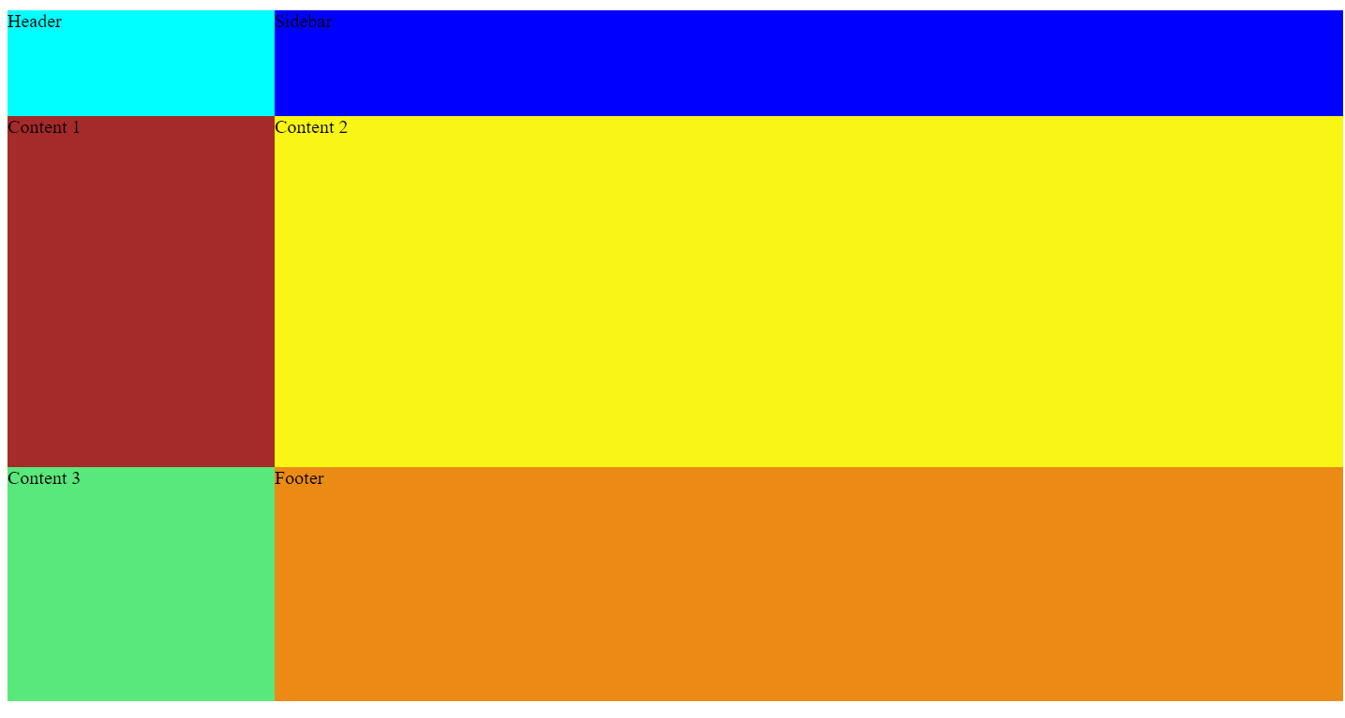

Slide 18
justify-content
justify-content specifies how browsers should position a grid container's columns along its row axis.
The justify-content property accepts the following values:
start
center
end
stretch
space-between
space-around
space-evenly

Slide 19
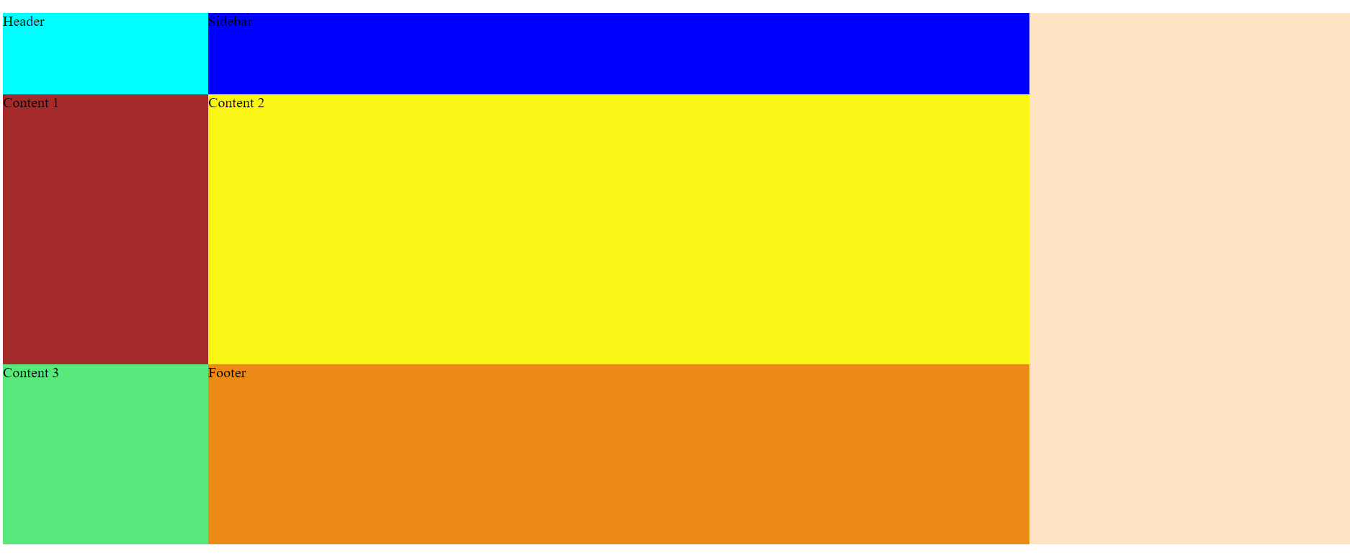
Justify-content:Start

Slide 20
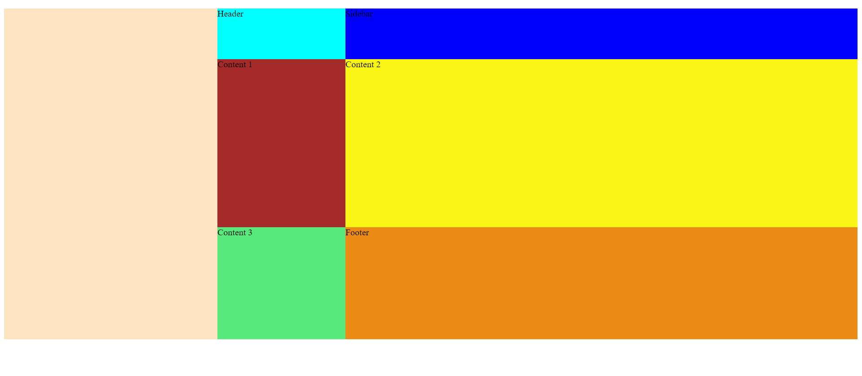
justify-content: end;

Slide 21
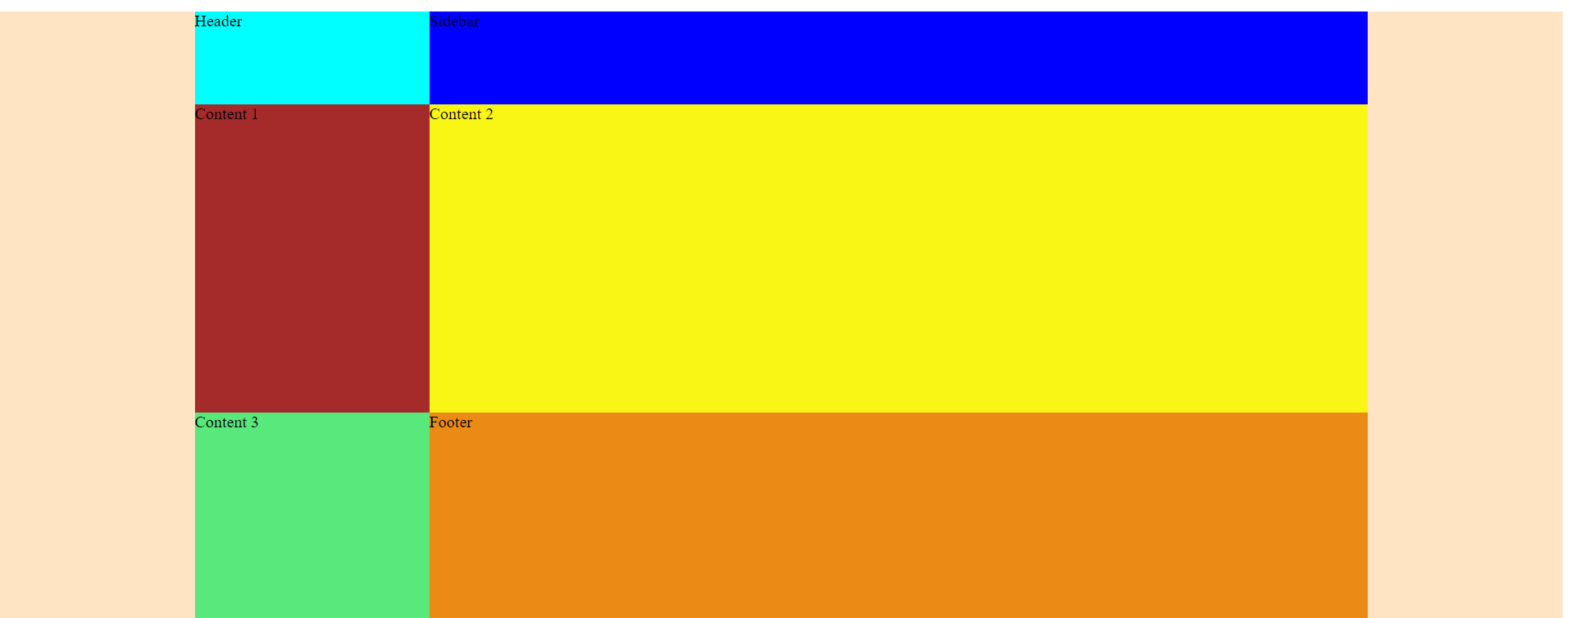
justify-content: center;

Slide 22
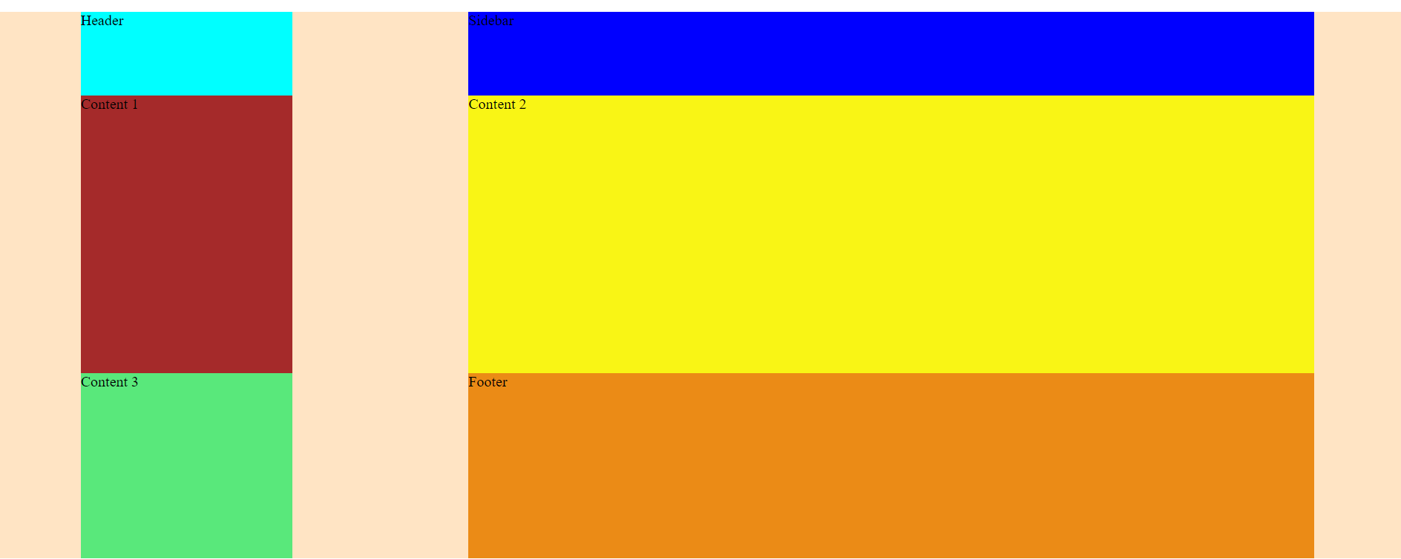
justify-content: space-around;

Slide 23
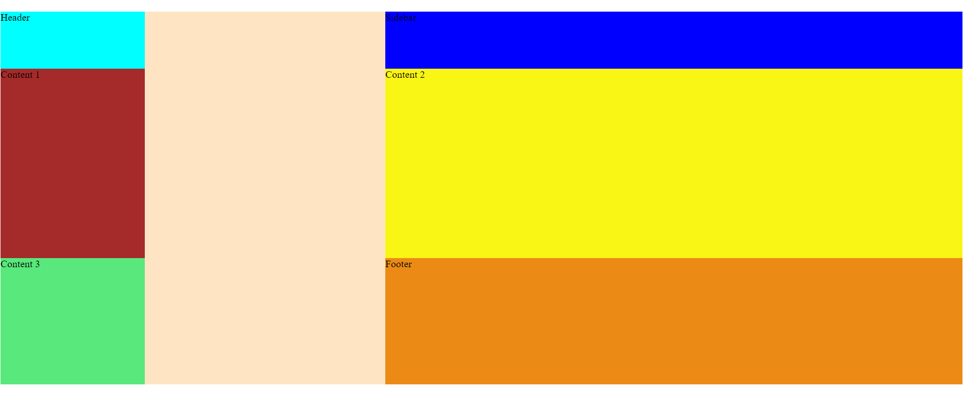
justify-content: space-between;

Slide 24
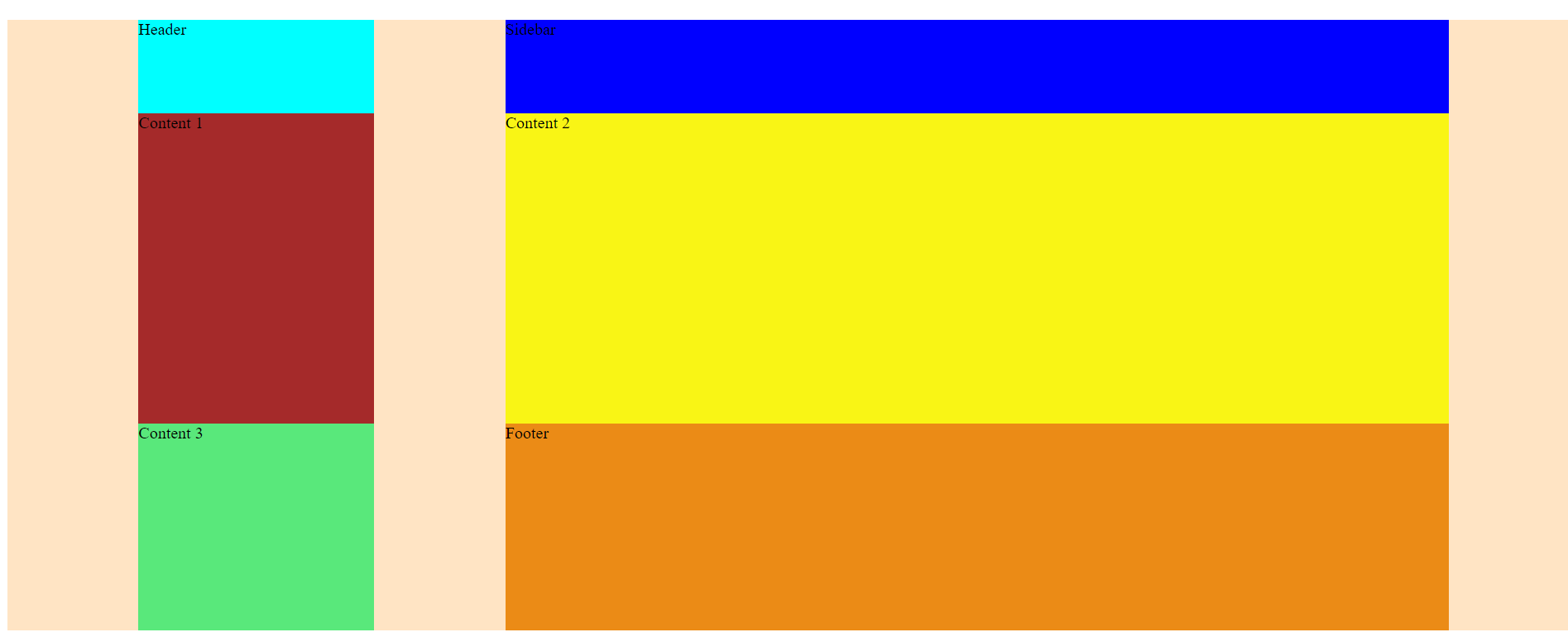
justify-content: space-evenly;

Slide 25
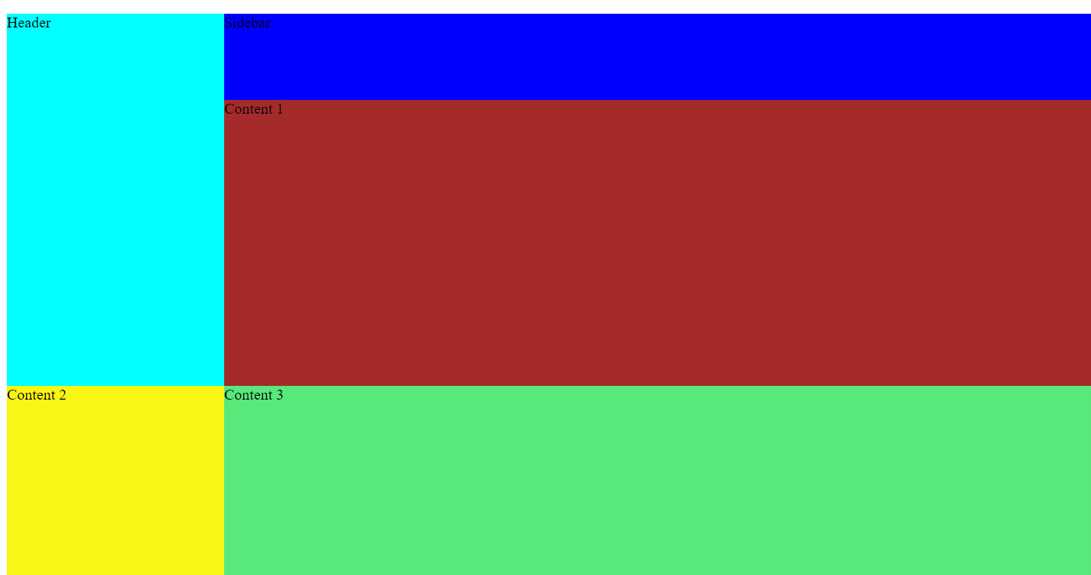
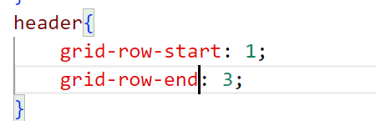
grid-row-start & grid-row-end
The CSS grid-row-start and grid-row-end properties allow single grid items to take up multiple rows

Slide 26
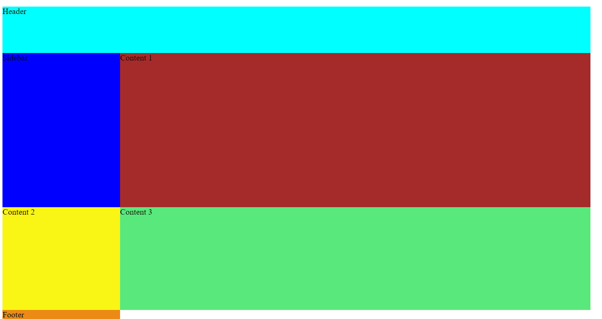
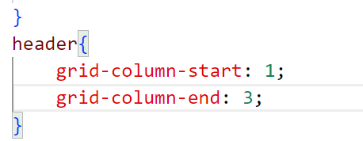
grid-column-start & grid-column-end

